Slide 1
Capstone Presentation
Customer Churn – E-Commerce Business
Presented By: Tejas Padekar

Slide 2
Agenda
Business Problem Understanding
Modeling Approach Used & Why
Insights & Recommendations

Slide 3
Business Problem Understanding
The company is facing ‘Customer Churn’ problem. About 17 percent customers have churned so far.
Customer Churn is one of the biggest global problem faced across all industries.
Extremely difficult problem to tackle due to intense competition in the E-commerce industry.

Slide 4
E-Commerce business has no entry barriers, works on a light business model, can be easily replicated and has a diverse customer base.
It is a major issue for our company as one account could have multiple users, thus multiplying losses tremendously.
Need a reliable Customer Churn Prediction Model, Insights and Recommendations which can help retain its existing customers.

Slide 5
Modeling Approach Used & Why
This Customer Churn prediction problem is a ‘Classification Problem’.
Focus was to build models which can achieve high recall value on test datasets for class 1 observations (customers who have churned).
Prominent Classification problem related modelling techniques were built and predicted on both train and test datasets.
The performances were tabulated using necessary performance measures such as accuracy, recall, precision, f-1 score and AUC.

Slide 6
Base
Model
Hyper Tuning
SMOTE

Slide 7
Followed up with extracting important features for models which performed well to find significant variables.
Performed 10 fold cross validation on these well performed models to check stability and consistency of the models.
The above process was continued on ensemble techniques as well.

Slide 8
Models Built
Model Name | Accuracy % |  | Recall % |  | Precision % |  | F1 % |  | AUC %
 | Train | Test | Train | Test | Train | Test | Train | Test | Train | Test
CART Tuned (Unscaled Dataset without Outliers) | 97 | 94 | 89 | 78 | 95 | 83 | 92 | 81 | 99 | 99
KNN_model (scaled data without outliers) | 98 | 95 | 90 | 80 | 97 | 89 | 93 | 84 | 99 | 99
SVM with SMOTE (scaled dataset without Outliers) | 95 | 93 | 92 | 82 | 93 | 76 | 92 | 79 | 99 | 99
Random Forest_model 5 - Hyper Tuned with SMOTE (unscaled data and with outliers) | 98 | 95 | 96 | 85 | 98 | 84 | 97 | 85 | 99 | 98
XGBoost Tuned (unscaled data and without outliers) | 100 | 97 | 99 | 88 | 99 | 92 | 99 | 90 | 100 | 99
SVM Tuned (scaled dataset without Outliers) | 100 | 98 | 99 | 91 | 100 | 95 | 99 | 93 | 99 | 99
KNN_model with SMOTE (scaled data without outliers) | 98 | 94 | 99 | 93 | 95 | 76 | 97 | 84 | 99 | 99

Slide 9
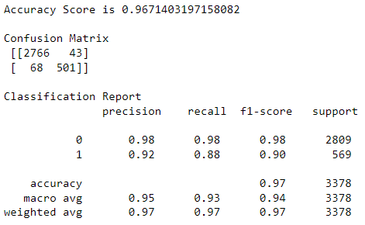
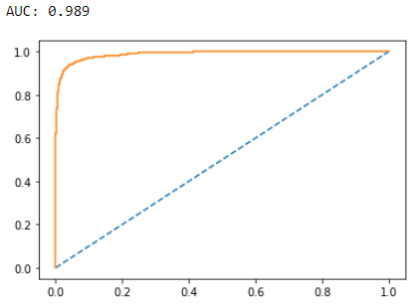
Best Model Performance
Model Name | Accuracy % |  | Recall % |  | Precision % |  | F1 % |  | AUC %
 | Train | Test | Train | Test | Train | Test | Train | Test | Train | Test
XGBoost Tuned (unscaled data and without outliers) | 100 | 97 | 99 | 88 | 99 | 92 | 99 | 90 | 100 | 99

Slide 10
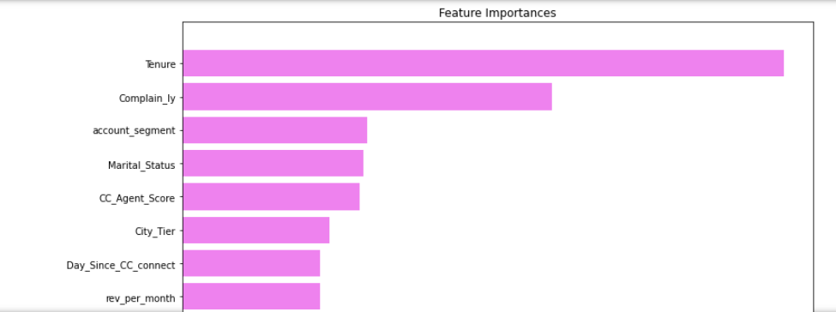
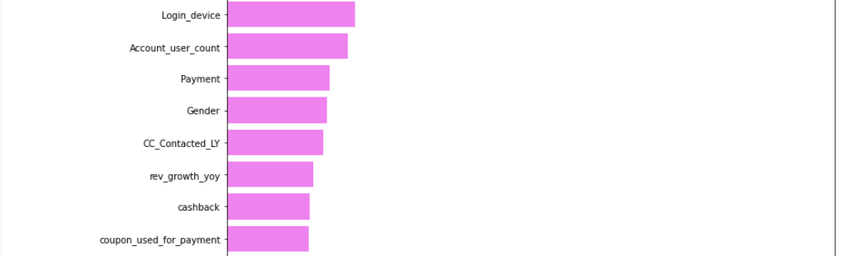
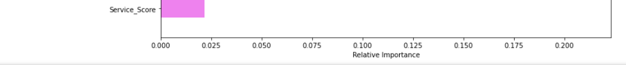
Best Model Important Features
Tenure of the account.
Complaints Raised in Last Year.
Account Segment basis of spends.
Marital Status of primary account holder.
Customer Care Agent Score.
City Tier of primary account holder.
Days Since Last Customer Care Connect.
Average Revenue Per Month for last year.
Login Device preferred.
Account Users Count.

Slide 11
Insights & Recommendations
Tenure was an important feature in all the models built.
Maximum accounts were added in the last couple of months (approx 23%) and the concern is that customers who are churning also have low average tenure of approx 3 months.
The business can introduce loyalty programs rewarding customers with different tenure slabs starting from 3 months and above.
Introduce referral benefits for tagging new users to the account or even offer redeem points to primary account holders on purchases made by the other users tagged to the account.

Slide 12
Complaint Raised in Last Year was an important feature in all the 7 models we selected to evaluate.
27.6% of accounts had raised complaints in the last one year (approx. 3000 accounts) and nearly 1/3rd of these had churned which is quite high.
Need to provide robust interface for seamless purchasing and transacting experience on their website and mobile application.
Arrange for feedback and surveys to understand customer sentiments and try and find areas which can create opportunity for complaints to tackle them beforehand. Dedicate a small team to exclusively handle customer, vendor and inter-company complaints.

Slide 13
Account Segment basis of spends was an important feature in all the 7 models we selected to evaluate.
Regular Plus, Super and HNI accounts are churning more than others.
Specific targeted offers/combos can be designed to boost spends for the ‘Regular Plus’ accounts which can move them to ‘Super’. Similar strategies can be formed for accounts of ‘Super’ category to move them to ‘Super Plus’.
Similar products/supplementary products based on interests, past purchases can be run under product recommendations and shared via email, push notifications etc for these specific segments.

Slide 14
Average Revenue Per Month for last year was also an important feature in all the models built.
Accounts that have churned contributed the highest average revenue per month of 6800 units. Overall average is approx. 6300 units.
Need to analyse their reviews. Request for feedback to understand their pain points and reward them with discounted offers/feedback points/free coupons/free gifts for contributing to the feedback.
Can consider upgrading them to a higher account segment and benefits that come with it to lure them back.

Slide 15
Customer Care Agent Score was an important feature in 90% of all the models built.
Surprisingly, customers who are giving a higher rating of 3 and above are churning.
The lowest score of 1, is the second highest rating given by a huge 20% of total accounts which is concerning.
Need to analyse how this data of satisfaction score is collected and if it is collected in a legitimate way to take necessary actions.
Track customer service performances and reward employees doing well. Special training sessions for customer service representatives can be arranged once in a while.

Slide 16
Days Since Last Customer Care Connect was an as an important feature in all the models built.
Approx 50% customers have contacted customer care between 0 to 3 days. However, higher the gap better are the chances of retention.
It was observed that customers using coupons to make payments connected with customer care more. So, need to smoothen the process to use coupons reducing the need for assistance and train staff for seamless assistance when contacted.
Make tutorials available to use the website and mobile application. Provide quick solutions through auto bots, show steps and suggestions to improve the purchase experience and can also hire more customer service staff to meet the demand.

Slide 17
Marital Status of primary account holder was an important feature in 5 of the 7 models we selected to evaluated.
Most of the primary customers are Married. However, maximum accounts churning are Single. Approx 28.5% of all Single primary customers have churned which is very high.
Inventory should include more trending and in fashion/style products. Special greeting wishes and offers for birthdays/anniversaries/special days can be released.
Can offer heavy discounts on select products as well to make it more attractive and affordable to youth. Can also run mega clearance sale on outdated and unsold inventory to try and trigger impulse buying.

Slide 18
City Tier of primary account holder was an important feature in 5 of the 7 models we selected to evaluated.
Accounts from City Tier 3 are churning at a faster rate at 17.6% compared to other city tiers.
Overall accounts for City Tier 2 is extremely low of only 4.2%.
Frequency of reaching customers to these city tiers need to be improved by increasing partners/vendors/distributors. Choose them diligently and incentivise them for excellent service.

Slide 19
Login Device preferred was also observed as important feature in 6 of the 7 models we selected to evaluated.
73% accounts prefer using mobile to login.
Ensure that both the website as well as mobile application is maintained, up and running smoothly and invest in technology and software to make them stronger, robust and richer.
Even signing up and subscriptions should be easy to execute.

Slide 20
Account Users Count was an important feature in 70% of all the models we built.
Accounts that have churned had an average of 4 users per account and most accounts have minimum 4 users itself.
Too many users in an account can also be a problem. Hence, it is advisable to limit users per account or avoid having multiple users tagged to one account completely.

Slide 21
THANK YOU

